Slide 1
Rollins College Course Management System
Project
TE
Phuc Dao
William Slowey
Alex Octuk
Fall
2025

Slide 2
Phuc Dao - System Integration & Design
Responsibilities
William Slowey
Responsibilities
Alex Octuk - GUI Design
Responsibilities
Team Members
Imported Rollins Spring 2026 catalog and merged into the database
Designed project concept and core features
Created full UML class diagram
Developed & designed the presentation
Designed methods for each action along with exception handling
Utilized the data structures to store data
Implemented login system for the GUI
Designed and implemented GUI base
Adapted methods to mesh with GUI structure
Developed project report

Slide 3
Our goal is simple: reduce frustration, prevent crashes, and make Rollins course registration stress-free.
Our vision
Concept Overview:
A course registration system modeled after Rollins College’s real enrollment structure
Allow students to register and manage their course schedule
Enable administrative management of users and classes
Each system element (Students, Professors, Departments, Courses) has unique IDs for fast searching (CRN, Student ID, etc.)
Built to be more stable and streamlined than the current Rollins system, which often struggles with performance during heavy use

Slide 4
DEMO
Demo

Slide 5
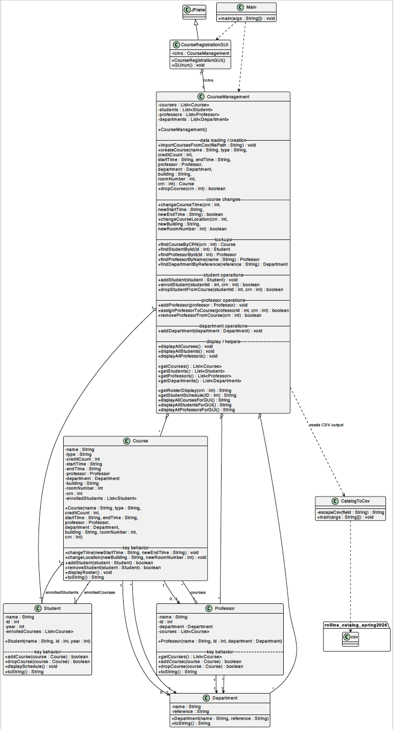
How We Used OOP Principles

Slide 6
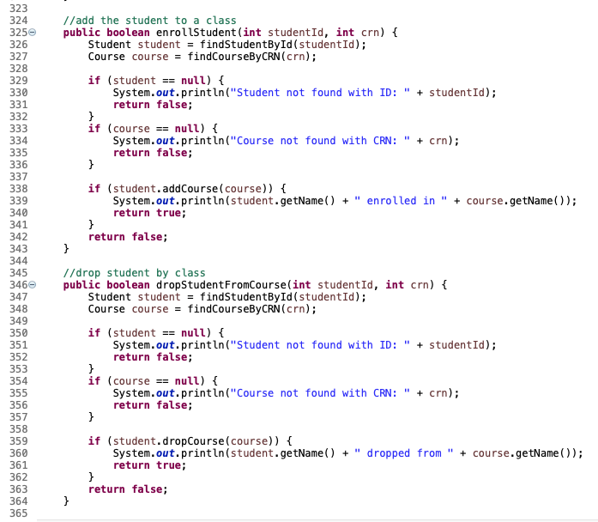
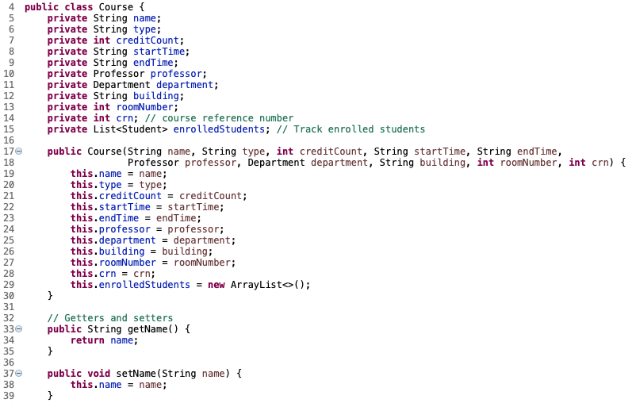
How We Used OOP Principles
Encapsulation
Abstraction
–Each core object (Student, Course, Professor, Department) has private fields with public getters and setters
- CourseManagement.java acts as the brain of the system
Handles high-level actions like enrollStudent(id, crn), dropStudentFromCourse(id, crn), findCourseByCRN(crn)

Slide 7
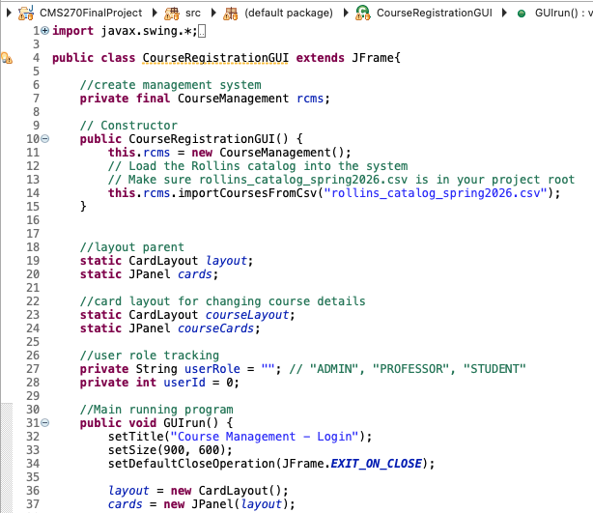
How We Used OOP Principles
Inheritance
Polymorphism & Composition
– The GUI class extends Swing components
– Polymorphism appears in how different user roles interact through the same system
The same backend (CourseManagement) supports Admin, Student, and Professor actions using different GUI screens
– Composition is used heavily
A Course contains a Professor and a Department
A Student contains a list of Course objects

Slide 8
UML
Challenges and Lessons Learned
Team
OOP
Timeline
Challenges
Lessons
Implementing and merging Course Catalog CSV into the system
Creating and designing methods to mesh with data structures
GUI Design and functionality
How to import and change the course catalog to match data structures used in system
  Learning BufferedReader and IOException implementation
How to align the needs of a method with the data structures used
  Visibility, static vs non-static/private
Fully implementing GUI functions and how to change screens for different functions
  Mapping structure of GUI
  Bookkeeping what screens go where and what is added to screens
$0M
$0M
$0M
$0M
$0M

Slide 9
Thank you!
THE END
Any Questions?

